Slide 2

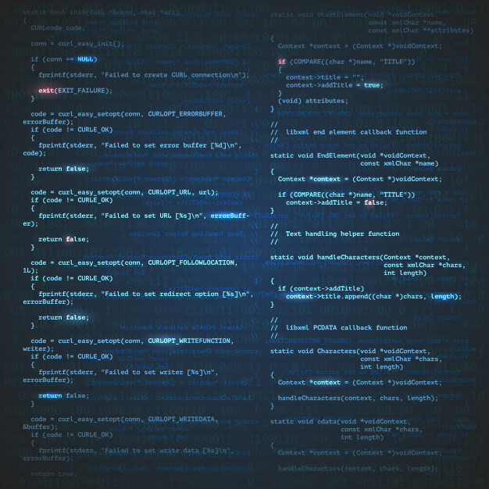
Compiler Construction

Slide 3
Presented by:
Krishan Rupani | Neha Singh | Payal Singla
500067535 | 500069028 | 500069630
R171218057 | R171218067 | R171218118
Under the guidance of:
Dr. Hitesh Kumar Sharma
Assistance Professor
Department of Cybernetics,
School of Computer Science

Slide 4
Introduction:
Compiler is not a unknown word to all of us, compiler is an integral part of our programming journey.
It converts our program written in any language to machine understandable code.
So a programmer writes the code in the compiler and compiler produces output according to the code or it produces error if the code is incorrect in anyway.
We are making a online web based compiler which will contain most of the language, in future and will reduce the trouble of installing many different compilers on your PC.
Inspiration to this project came from my own suffering, I have a PC with good computational power but because I do a lot stuff managing so many different compilers for every language made my life really tough.
Another problem that I have noticed is many edtech startup wishes to have a in build compiler on their web application, we are trying to solve that problem.

Slide 5

The Problem:
Why we need this compiler
Managing different compilers for different languages can be overwhelming for programmer and its computer as well.
There are some online compilers but most of them are language specific.
Online compiler do have a bad reputation of slow processing and not effective a presentation of errors
Many edtech startups want a compiler in-build in their web application but they don’t have it cause of development issues or the proper APIs are not available etc.

Slide 6

Objective:
Our aim for this minor project 1 is:
To create a web based compiler for subset of C language.

Slide 7
How Compiler Works:
Lexical Analysis
Syntax Analysis
Semantic Analysis
Intermediate Code Generator
Code Optimization
Code Generators
In order to convert the source code in machine understandable code, the source code has to pass 6 phases.
Error handler
Machine
code
Source code
Symbol Table

Slide 8
Knowledge Required & Algorithms:
Scanning & tokenization
Grammar Rules
Scanning & Parsing
Regular Expressions
Finite State & Finite Automata
DFA & NFA
CFG & Ambiguity
AST
Backus Naur Form: BNF
Top-Down Parsing: LL Parsing

Slide 9
Market Analysis:
We have a huge market for us, our target audience consists of programmers who have just started learning ideally students and for our B2B service we have a audience of all the edtech startup who are providing learning in programming.
There are many compiler out in the market like Jetbrains a software company with annual revenue of $270M and others like Codeblocks, Visual Studio and many other compilers available for different programming languages but most of them are for desktop and require some sort of specification to run properly.
We have online compilers like GDB which provide compilation in most languages but they don’t have a attractive UI and interactive UX.

Slide 10
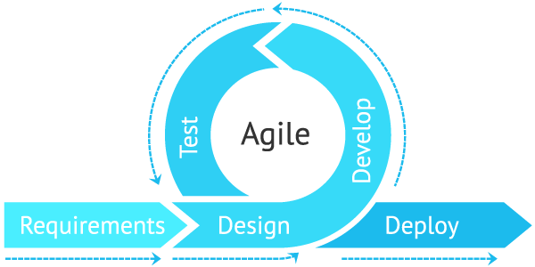
Methodology:
We will make our project using agile methodologies following agile values and principals.
Agile project management is a methodology that is commonly used to deliver complex projects due to its adaptiveness. It emphasizes collaboration, flexibility, continuous improvement, and high quality results.

Slide 11
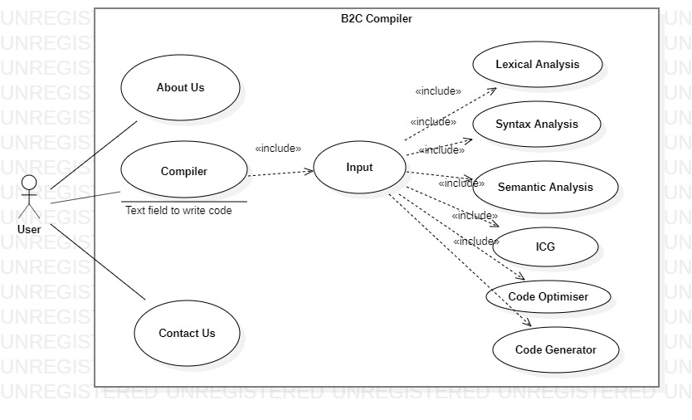
Diagram:

Slide 12
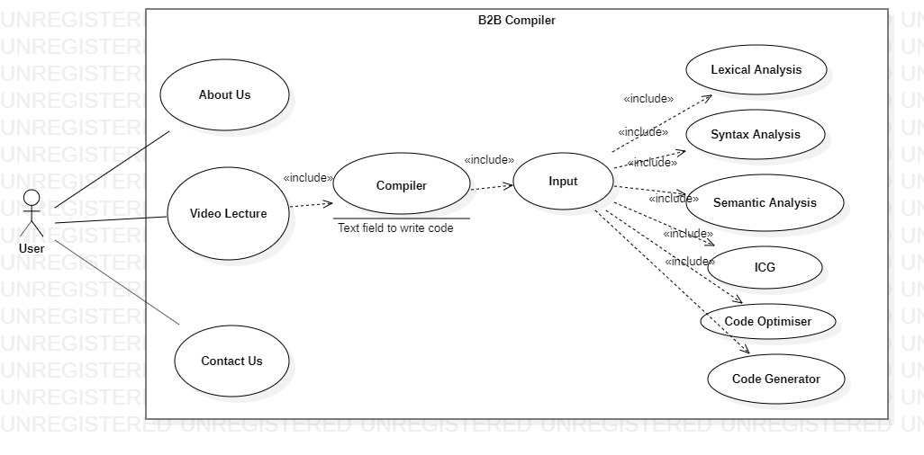
Diagram:

Slide 13
Schedule:
Reviews and Updates
Problem Identification and Understanding
Duration: 5 days
Literature review
Duration: 10 days
Product Design
Duration: 2 days
Development stage
Testing and debugging
Duration: 48 days
Deploy
Duration: 10 days
Duration: 5 days
Start
Project Complete
Documentation

